Slide 1
IPD Phase 1 presentation
Yung Kim

Slide 2
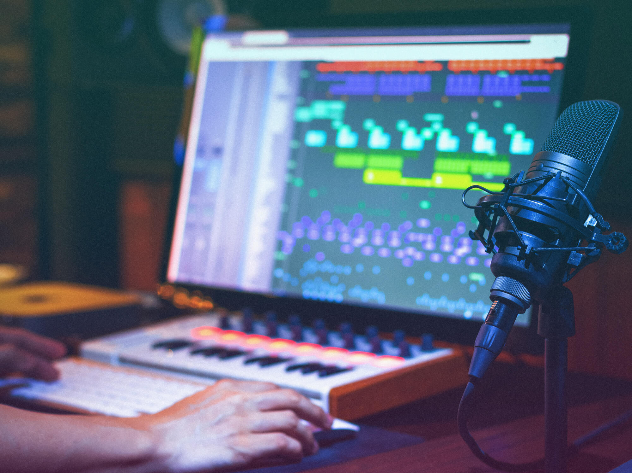
1. Base of Idea
0 - Making Music : How can we?

Slide 3
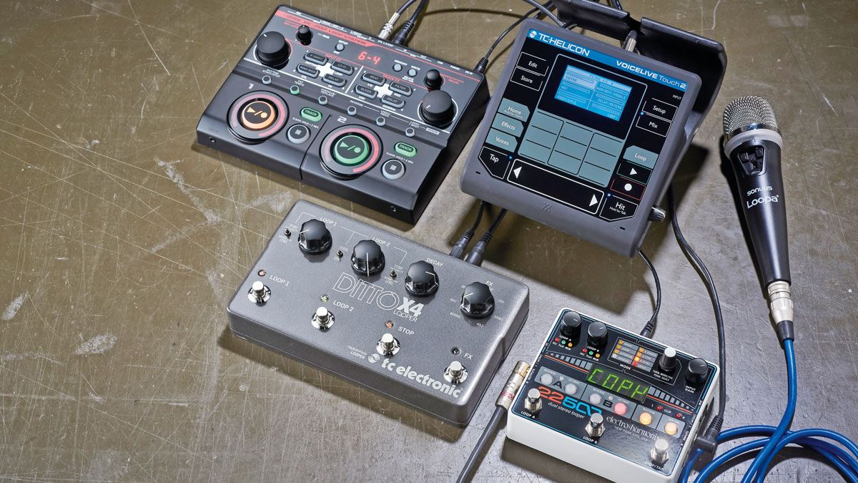
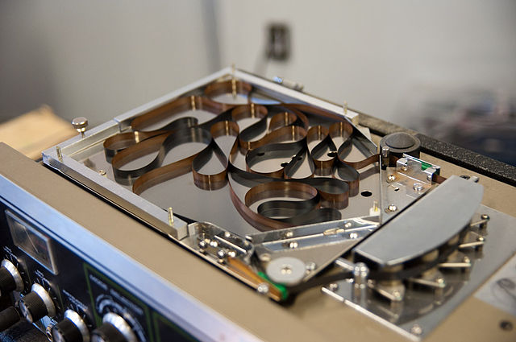
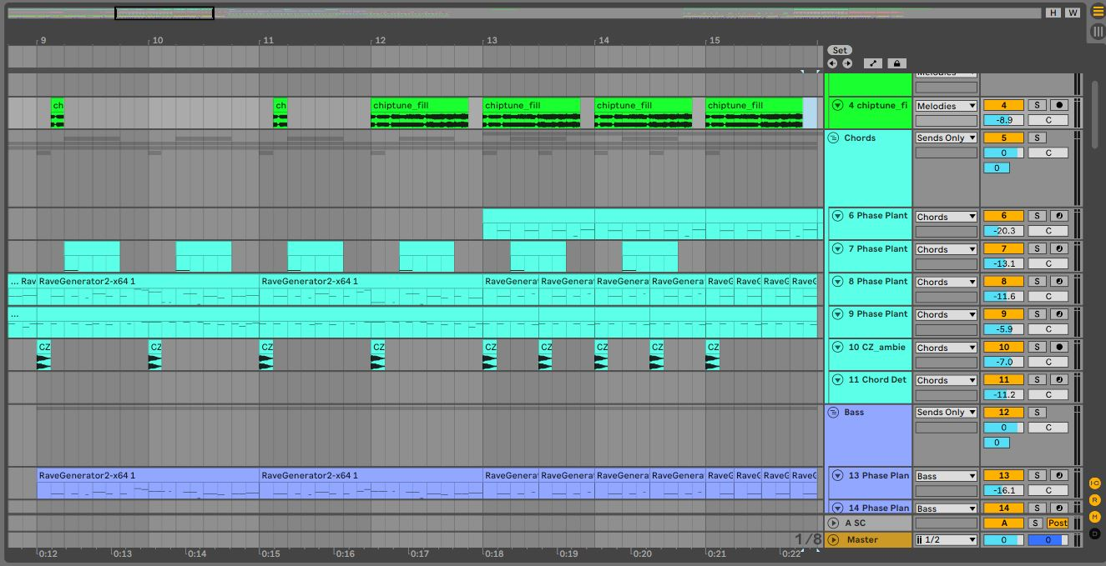
1. Base of Idea
1 - Looping : loop is a repeating section of sound material.

Slide 4
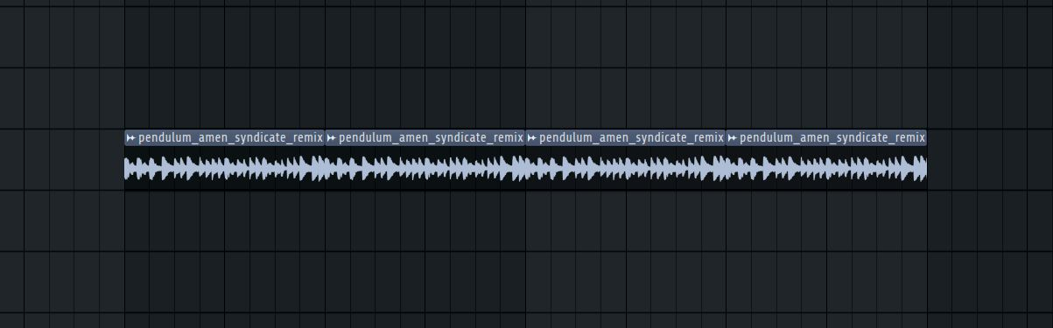
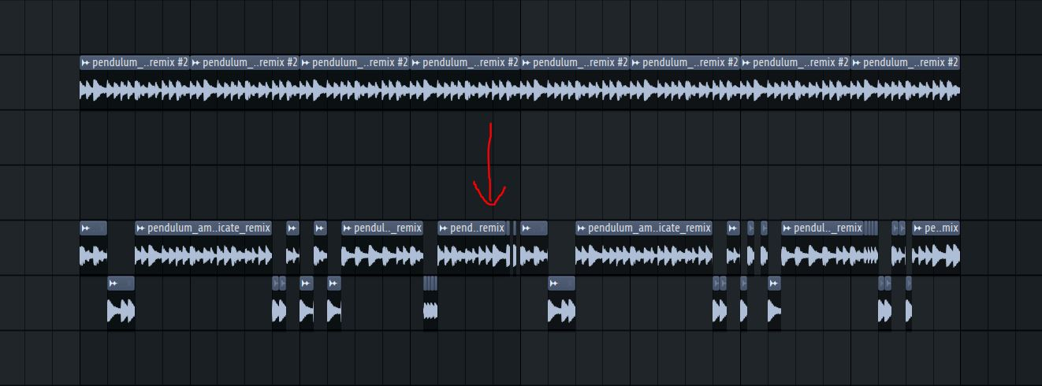
1. Base of Idea
2 - Sampling : To use looping, we need an audio “sample” to loop
(ex : drum breaks)
not only looping, but also chop and sticking the sample -> create a new one
divide into chunks

Slide 5
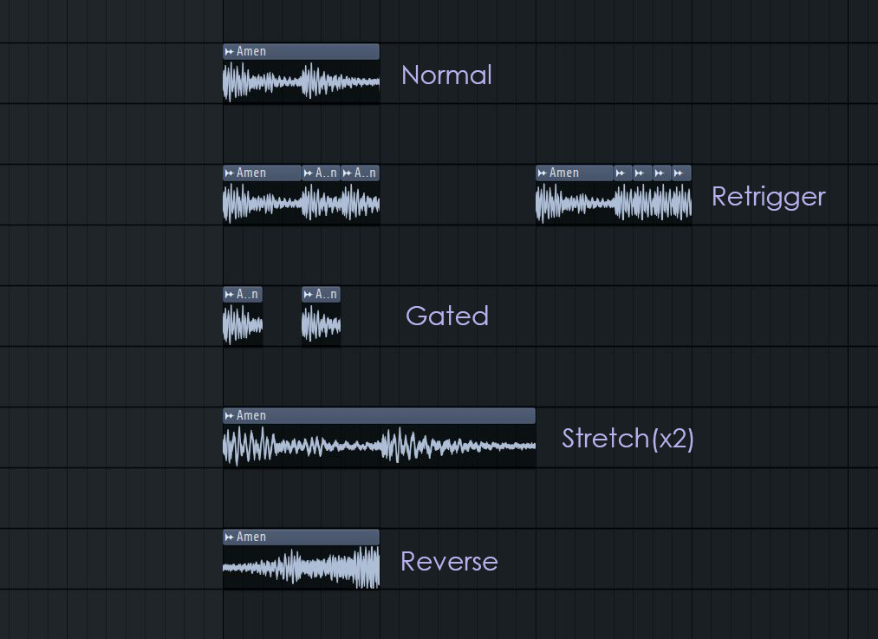
1. Base of Idea
We can even add some variations to the loop like this:
how does it sounds
like?

Slide 6
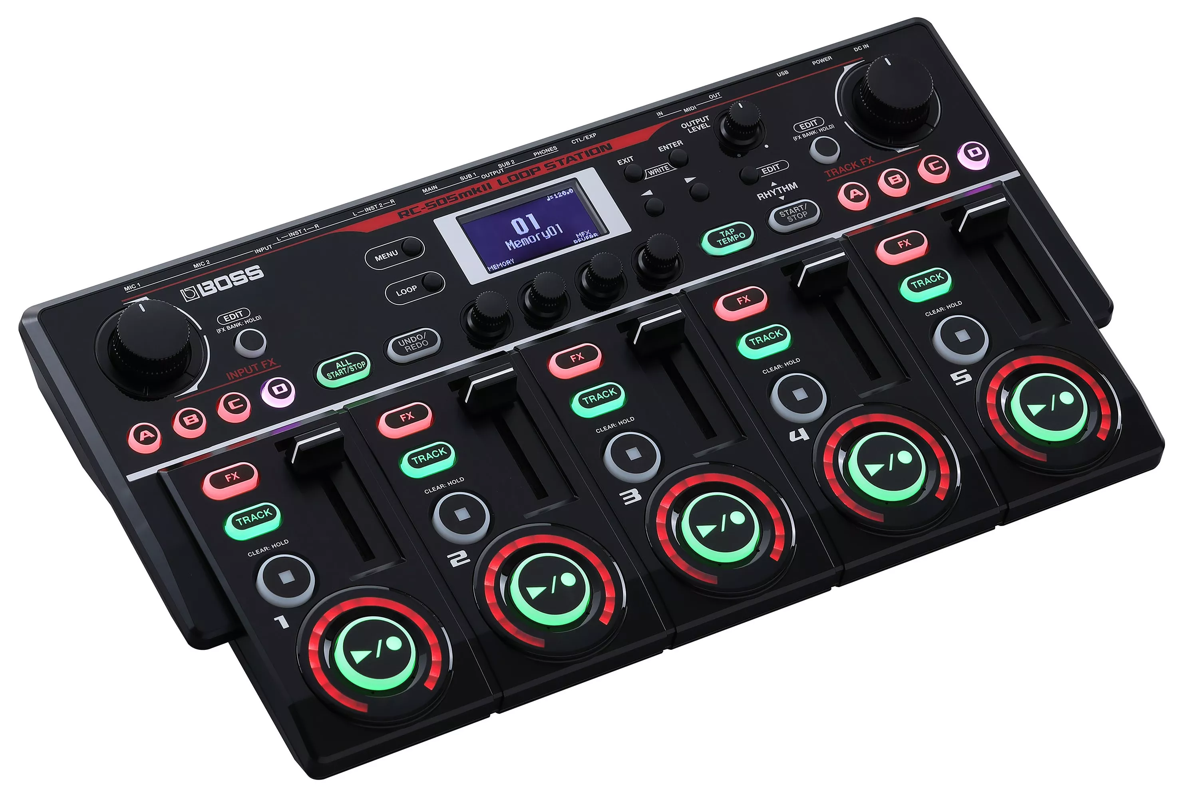
2. Related Works
- Representative product : Boss RC-505
https://www.youtube.com/watch?v=uJeNnw1Bz74

Slide 7
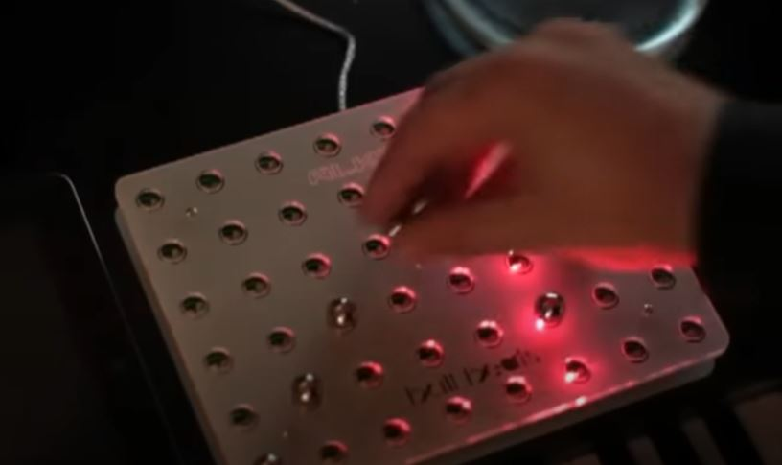
2. Related Works
- Creating a new loop from sample - “Ball Beats”
https://www.youtube.com/watch?v=kIl3cVeDnYo&t=68s

Slide 8
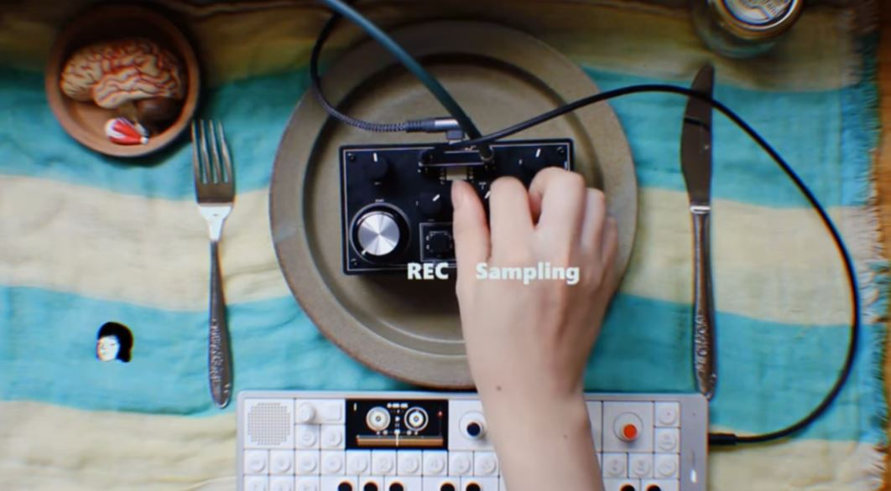
2. Related Works
- Lo-Fi Looper with Tape Effect (with internal recording)
https://www.youtube.com/watch?v=0MQ6ciVd2kw

Slide 9



3. Main Concept
- implementing the hardware looper, focused on chopping and sticking the audio sample
actually can also done with software scale
live-looping
edit patterns / samples with real-time
add tape effect, retrigger, reverse playing, ... for variations
live-recording
can be done with stereo mix or external sources
-> use the recorded sound as sample
- Spanish guitar drum and bass live loop (reference)
https://www.youtube.com/watch?v=MZ6jrGiDWcw

Slide 10
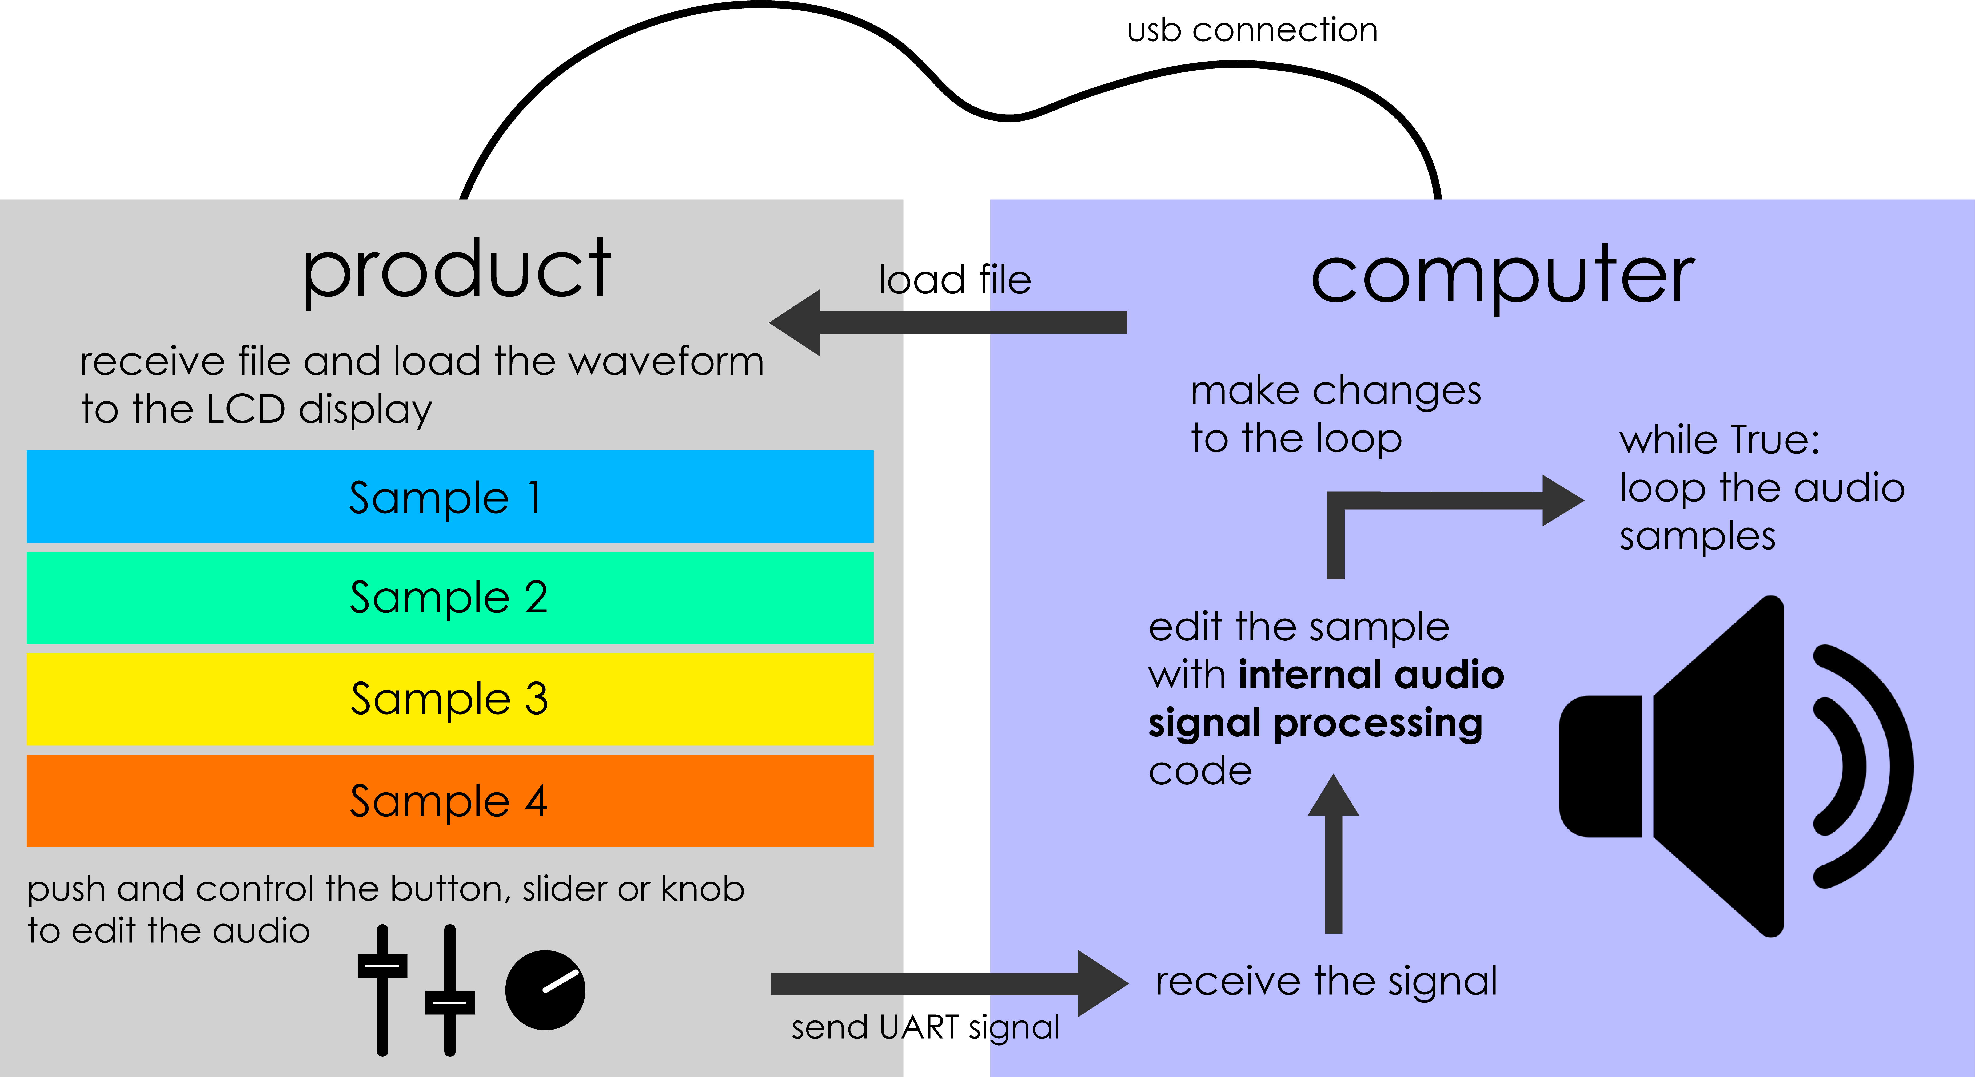
3. Main Concept

Slide 11
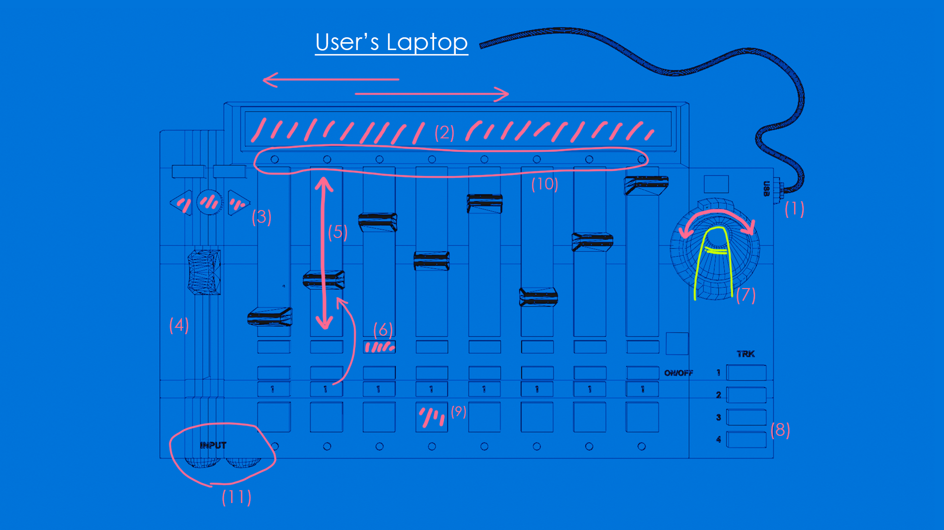
4. Product Design

Slide 12
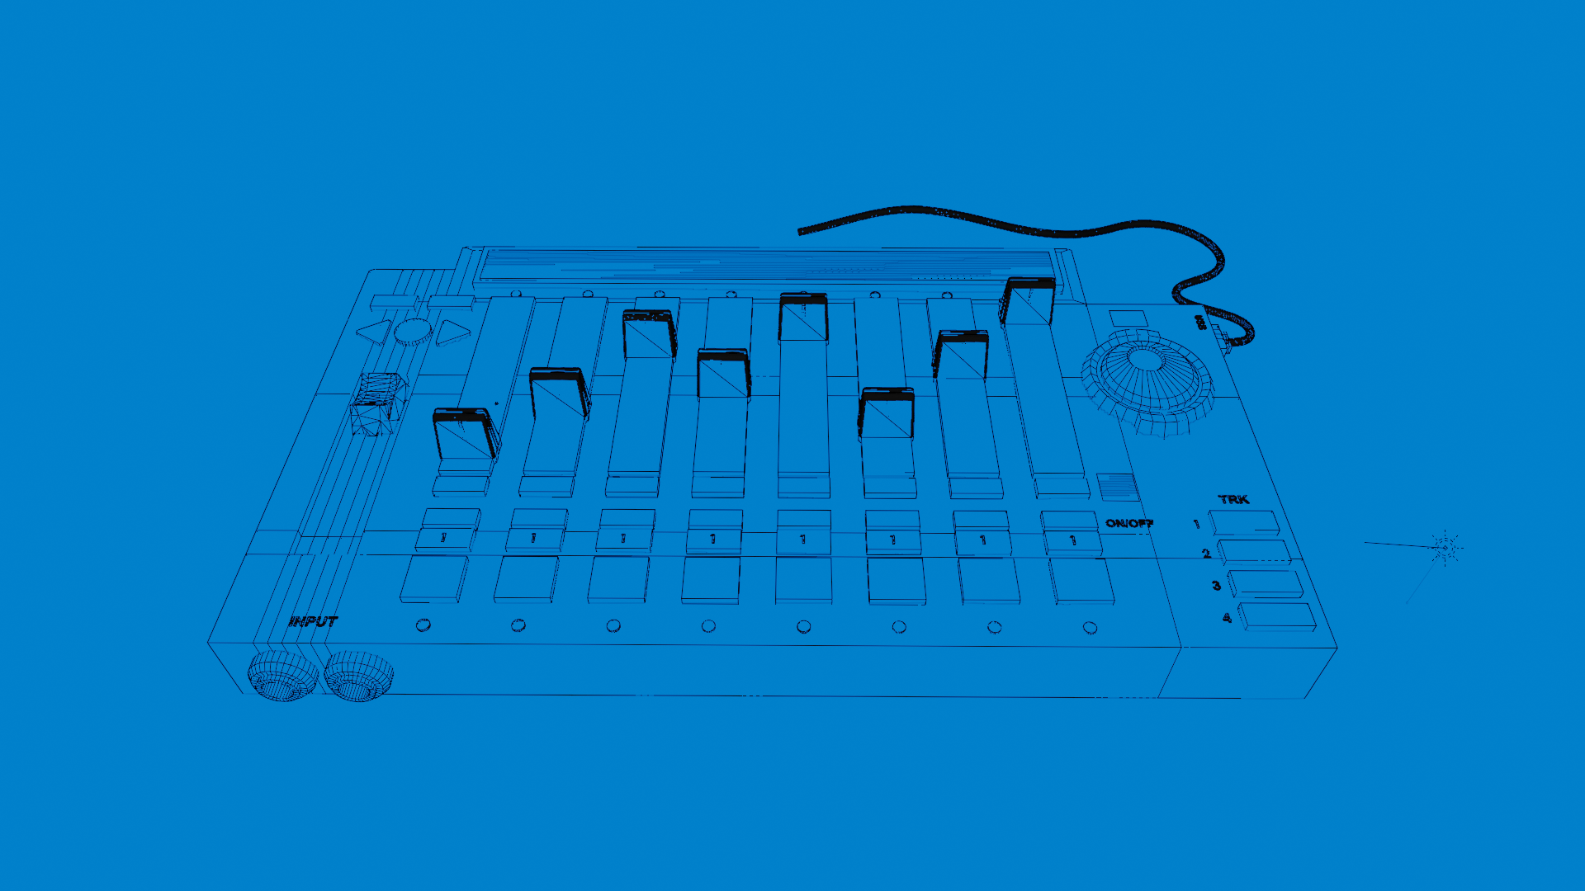
4. Product Design

Slide 13
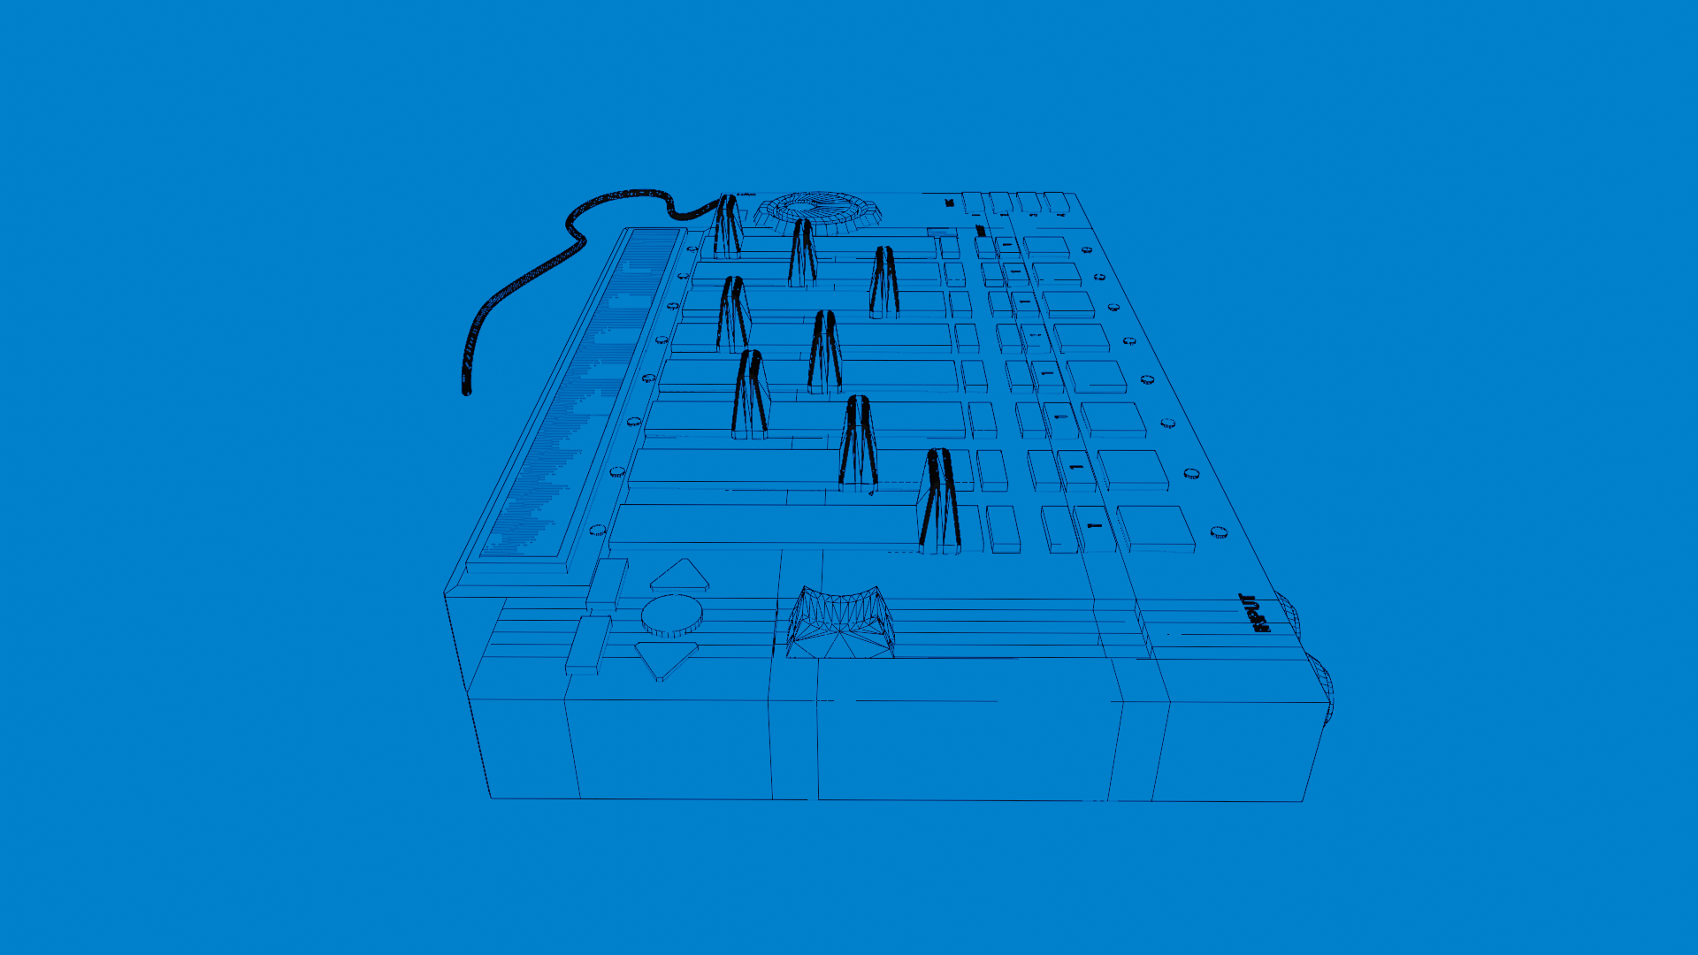
4. Product Design

Slide 14
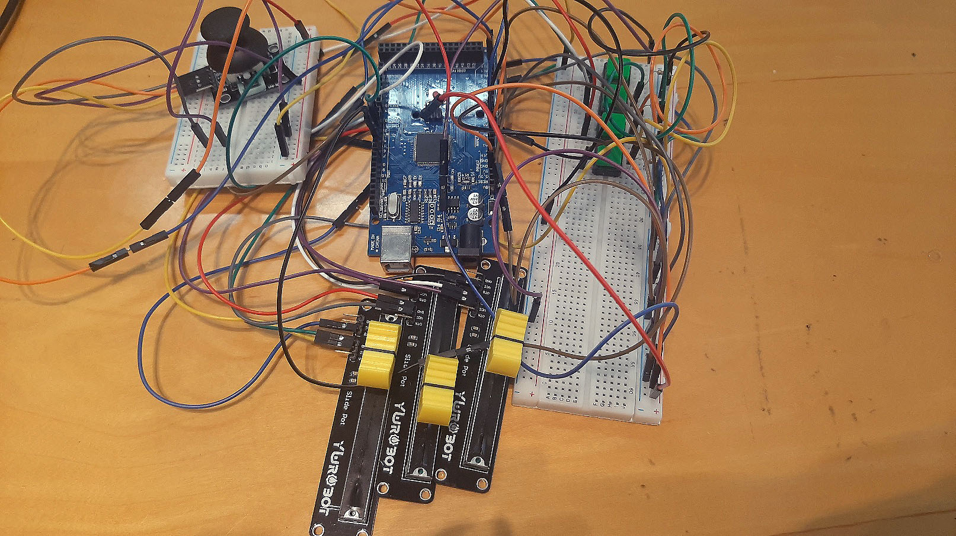
5. Early Prototype
because I haven’t
able to implement
a realtime looping
this time, I will
propose only applying sample editting and
effects on chunk

Slide 15
6. Next Step
1. Replacing the arduino board to Raspberry Pi
2. Figuring out the way to edit the loop in realtime
3. Algorithm of implementing Tape Effect

Slide 16
Thank You!
Any questions?

